Slide 1
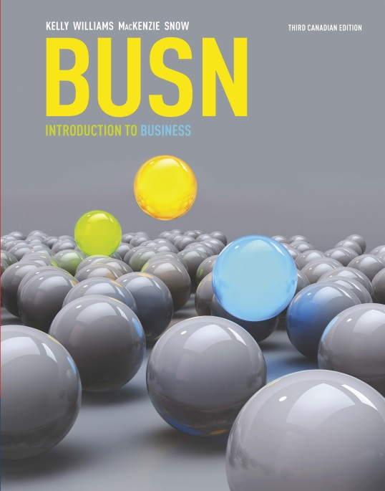
Chapter 3: Economics
The Framework for Business
Notes:
Copyright © 2011 by Nelson Education Limited
1

Slide 2
Looking Ahead
3-1 Define economics and discuss the global economic crisis.
3-2 Analyze the impact of fiscal and monetary policy on the economy.
3-3 Explain and evaluate the free market system and supply and demand.

Slide 3
Looking Ahead
3-4 Explain and evaluate planned market systems.
3-5 Describe the trend toward mixed market systems.
3-6 Discuss key terms and tools to evaluate economic performance.

Slide 4
Macroeconomics versus Microeconomics
Macroeconomics – country’s overall economy
Microeconomics – consumers, families, and businesses
Notes:
Copyright © 2011 by Nelson Education Limited
4

Slide 5

3-1 Global Economy: Slow Growth in the Near Future
Impact factors on the Canadian economy:
Canadian dollar hovering around US$0.72 in early 2016.
Low price of oil on the world market dropping from US$107 per barrel in summer of 2014 to less than US$30 in early 2016.
Notes:
Copyright © 2011 by Nelson Education Limited
5

Slide 6
3-2 Managing the Economy Through Fiscal and Monetary Policy
The goal is controlled, sustained growth through both fiscal and monetary policy.
Notes:
Copyright © 2011 by Nelson Education Limited
6

Slide 7
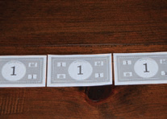
A Trillion Dollars
If you had started spending a million dollars – every day, without fail – at the start of the Roman Empire, you still wouldn’t have spent a trillion dollars by 2010.
One trillion dollars laid end-to-end would stretch farther than the distance from the earth to the sun.
Notes:
Copyright © 2011 by Nelson Education Limited
7

Slide 8
A Trillion Dollars
You could wrap your chain of bills more than 12 000 times around the earth’s equator.
If you flew a jet at the speed of sound, spooling out a roll of dollar bills behind you, it would take you more than 14 years to release a trillion dollars.

Slide 9
3-2 Managing the Economy Through Fiscal and Monetary Policy
Fiscal policy – taxation and spending decisions influence the economy; these decisions are designed to encourage growth, boost employment, and curb inflation
Monetary policy – actions that shape the economy by influencing interest rates and the supply of money; controlled by the Bank of Canada
Notes:
Copyright © 2011 by Nelson Education Limited
9

Slide 10
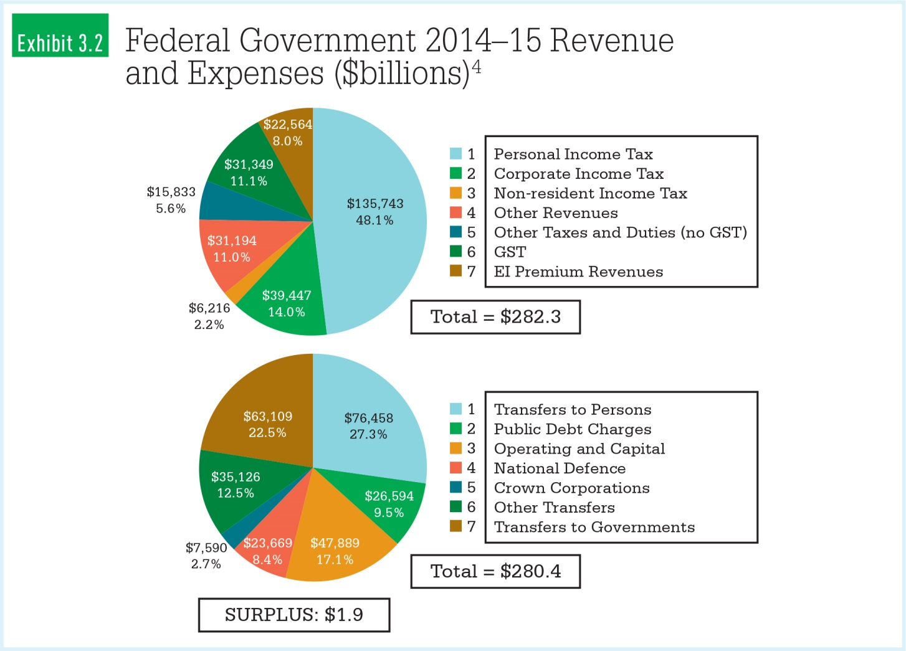
Federal Government Revenue and Expenses 2014–2015
[[CATCH: Exhibit 3.2 (Federal Government 2014-15 Revenue and Expenses) from p. 38 in the textbook]]
Notes:
Copyright © 2011 by Nelson Education Limited
10

Slide 11
Money Supply: M1 and M2
M1 money supply – all currency – paper bills and metal coins – plus chequing accounts and traveller’s cheques
M2 money supply – all M1 plus most savings accounts, money market accounts, and certificates of deposit (low-risk savings vehicles with a fixed term)
Notes:
Copyright © 2011 by Nelson Education Limited
11

Slide 12
Banks Multiply Money
Canadian banks hold about 2% of your deposit as a reserve.
You deposit $5000.
The bank loans Lianxi $4900.
Lianxi buys a car from Mohamed for $4900.
Mohamed deposits the $4900.
Although you still have $5000, the money supply has increased to $9900.
Notes:
Copyright © 2011 by Nelson Education Limited
12

Slide 13
The Bank of Canada
Manages Canada’s monetary policy
Provides banking services for other banks and the government
Coordinates the cheque-clearing process
Maintains the federal government’s chequing account
Keeps the currency supply in good condition
Notes:
Copyright © 2011 by Nelson Education Limited
13

Slide 14
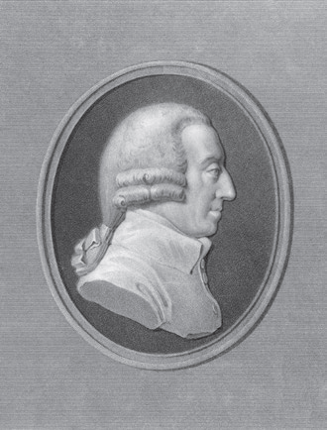
3-3 Capitalism: The Free Market System
Free market – private ownership, economic freedom, fair competition, and innovation and hard work
Businesses offer value to:
Customers
Employees
Suppliers
Notes:
Copyright © 2011 by Nelson Education Limited
14

Slide 15
The Fundamental Rights of Capitalism
The right to own a business and keep after-tax profits
The right to private property
The right to free choice
The right to fair competition
Notes:
Copyright © 2011 by Nelson Education Limited
15

Slide 16
Four Degrees of Competition
Pure competition
Monopolistic competition
Oligopoly
Monopoly
Notes:
Copyright © 2011 by Nelson Education Limited
16

Slide 17

Supply and Demand: Fundamental Principles of a Free Market System
The foundations of a free market
How much can we make/sell?
How much will consumers buy?
At what price?
Interaction of buyers and sellers
Impacts prices
Competition
Notes:
Copyright © 2011 by Nelson Education Limited
17

Slide 18
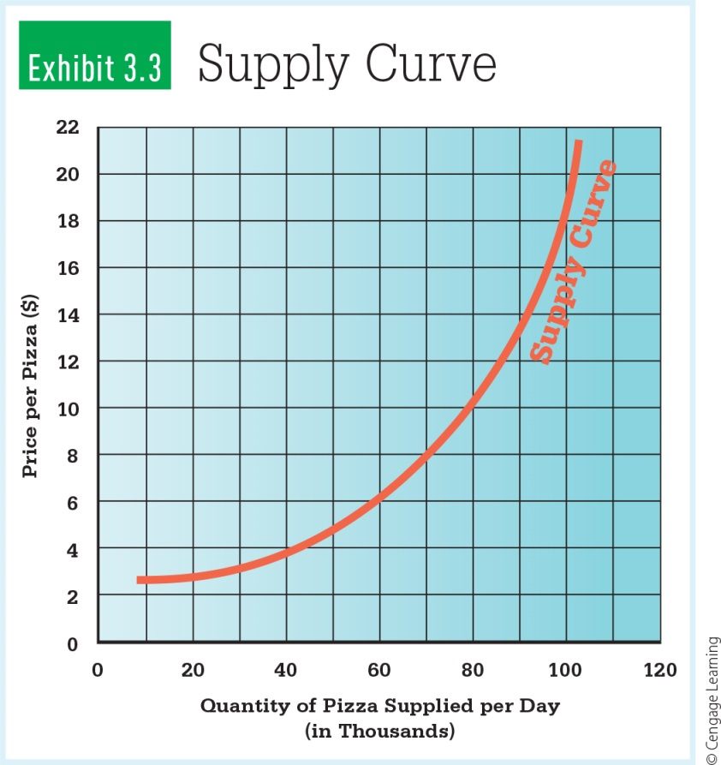
Supply: How Much to Produce? To Charge?
Supply – the relationship between the price of a good and the quantity that sellers are willing and able to offer for sale; sellers tend to supply a greater quantity as the price rises
Notes:
Copyright © 2011 by Nelson Education Limited
18

Slide 19
Supply: How Much to Produce? To Charge?
Supply curve – a graph of the supply relationship; the supply curve slopes upward to the right showing that the quantity supplied increases as the price rises

Slide 20
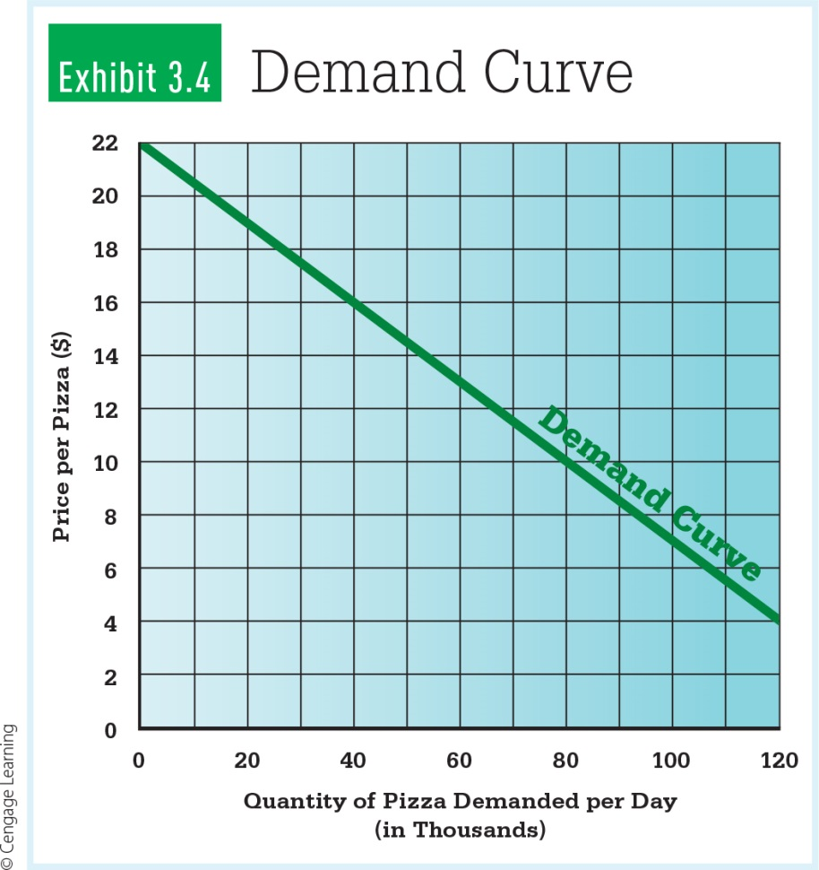
Demand: How Much Will Buyers Purchase?
Demand – the relationship between the price of a good and the quantity buyers are willing and can afford to buy; when price falls, consumers tend to buy more
Notes:
Copyright © 2011 by Nelson Education Limited
20

Slide 21
Demand: How Much Will Buyers Purchase?
Demand curve – a graph of the demand relationship; the demand curve slopes downward showing that the quantity demanded increases as the price falls

Slide 22
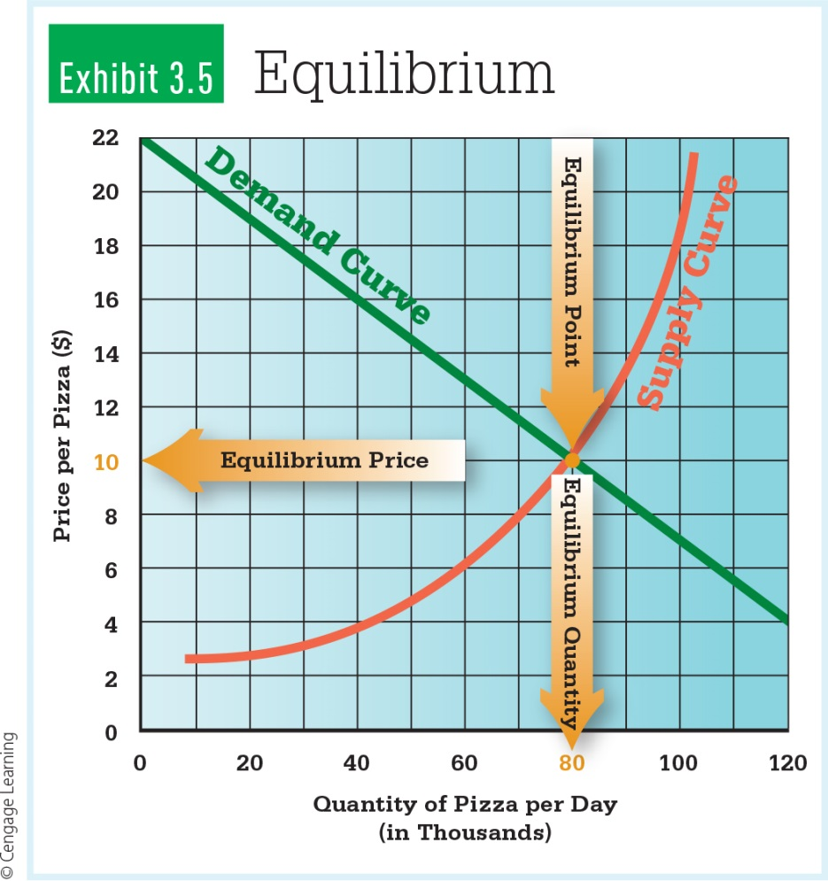
Equilibrium Price
Forces of supply and demand drive equilibrium price
The point where supply and demand intersect
Market price adjusts to the equilibrium price
Notes:
Copyright © 2011 by Nelson Education Limited
22

Slide 23
Pay as You Throw
Some municipalities are charging residents for every piece of trash they throw away.
Residents are motivated not only to recycle more but also to think about ways to generate less waste.
This can create jobs while also helping the environment.
Notes:
Copyright © 2011 by Nelson Education Limited
23

Slide 24
3-4 Planned Economies: Socialism and Communism
Socialism – the government controls key enterprises; higher taxes designed to distribute wealth through society
Communism – public ownership of all enterprise; strong central government
Notes:
Copyright © 2011 by Nelson Education Limited
24

Slide 25
Economic Systems: Different Ways to Allocate Resources
Free Market
Planned Economies
Capitalism
Socialism
Communism
Mixed Economies
Notes:
Copyright © 2011 by Nelson Education Limited
25

Slide 26
3-5 Mixed Economies: The Story of the Future
Market and planned economies don’t meet all of society’s needs; for example, the old, the young, the sick, and the environment could suffer.
Planned economies will not create enough value.
Notes:
Copyright © 2011 by Nelson Education Limited
26

Slide 27
3-5 Mixed Economies: The Story of the Future
As a market-dominant economy, the Canadian government still owns/supports the postal service, universities, parks, libraries, health care, education, defence, and public works.

Slide 28
Mixed Economies: The Story of the Future
“
As mixed economies become the story of the future, how much government intervention is too much?
When buying and selling are controlled by legislation, the first things to be bought and sold are legislators.
– P.J. O’Rourke,
political satirist, journalist, writer
What industries should be regulated? Why?
“
Notes:
Copyright © 2011 by Nelson Education Limited
28

Slide 29
3-6 Evaluating Economic Performance: What’s Working?
Gross Domestic Product
Employment Level
The Business Cycle
Price Levels
Productivity
Notes:
Copyright © 2011 by Nelson Education Limited
29

Slide 30
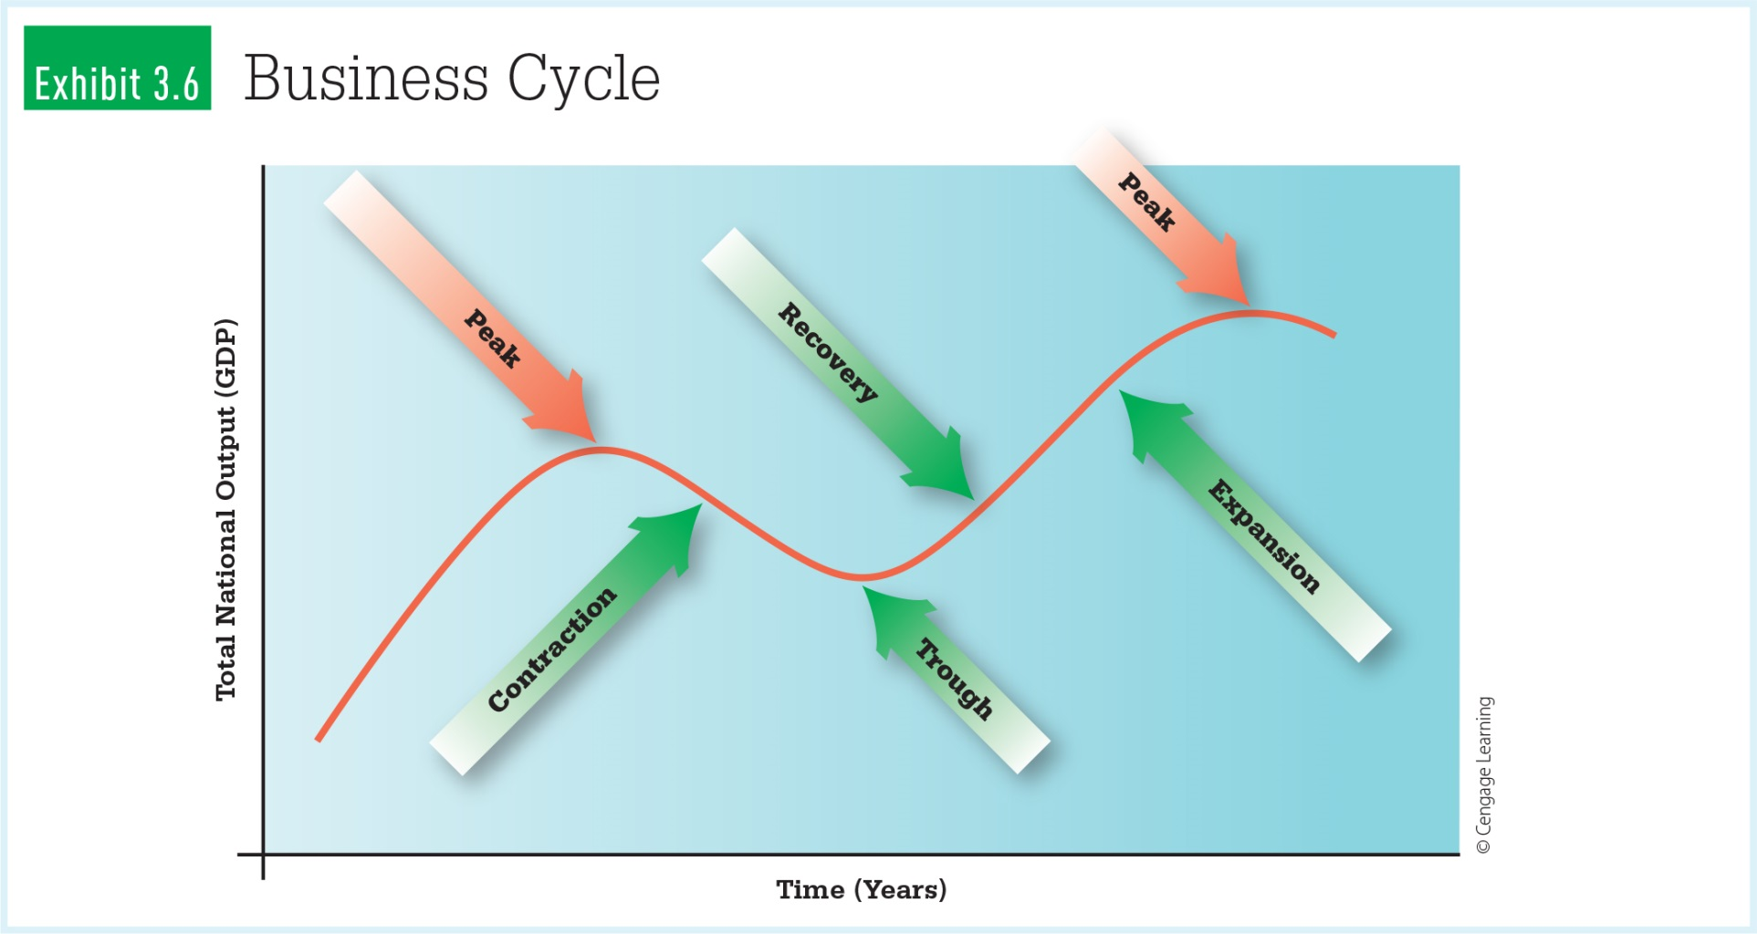
The Business Cycle
Notes:
Copyright © 2011 by Nelson Education Limited
30

Slide 31
Inflation
The rate of price changes across the economy is another basic measure of economic well-being.
Inflation means that prices are rising.
Hyperinflation is when average prices increase more than 50% per month.
Notes:
Copyright © 2011 by Nelson Education Limited
31

Slide 32
Inflation
Disinflation is when price increases slow down.
Deflation is when average prices actually decrease.
The government measures prices using the consumer price index (CPI) and the producer price index (PPI).

Slide 33
Productivity
The relationship between inputs and outputs is productivity.
A high level of productivity correlates with a healthy GDP.
Canada has experienced strong productivity growth due to technology.
Notes:
Copyright © 2011 by Nelson Education Limited
33

Slide 34
Looking Back
What is economics?
What is driving the current global economic crisis?
How does fiscal and monetary policy impact the economy?
What is the free market system and the supply and demand relationship?

Slide 35
Looking Back
What are planned market systems?
What are mixed market systems?
What tools are used to evaluate economic performance?

